Slide 1
Counterfeit Dental Material & Devices And Its Effects
Dr.yazeed Alshowaier

Slide 2
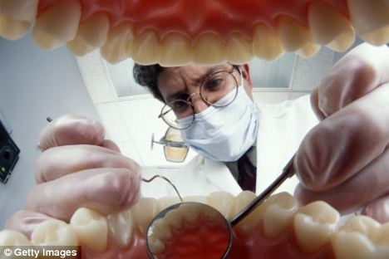
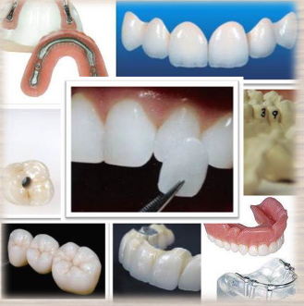
What’s In Your Mouth Matters
Dental restorations can affect your overall health
Do you have any of these?
Restoration
Dentures
Crowns
Bridges
Veneers
Implants
Orthodontic Appliances

Slide 3
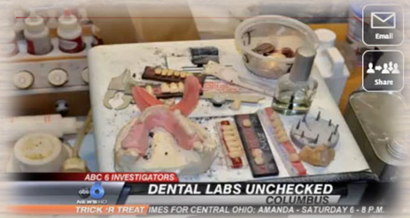

Who makes them?
Dentist and dental laboratory technician
Where are they made?
In dental Clinic and in dental laboratory
The Deal in Dentistry :
Standards DO Exist

Slide 4
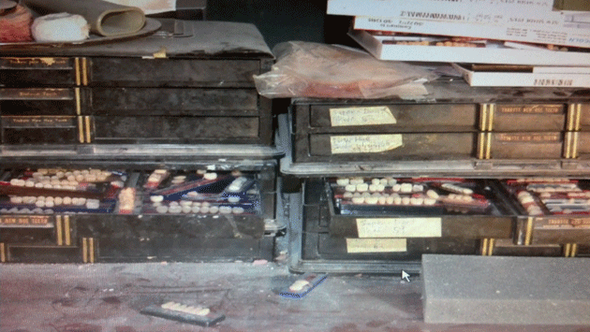
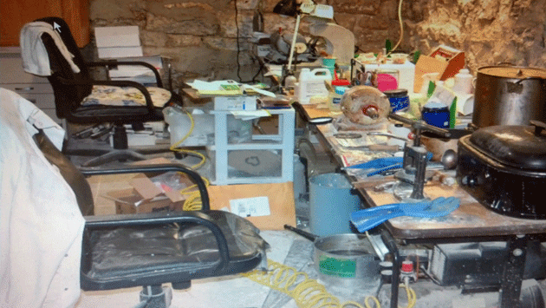
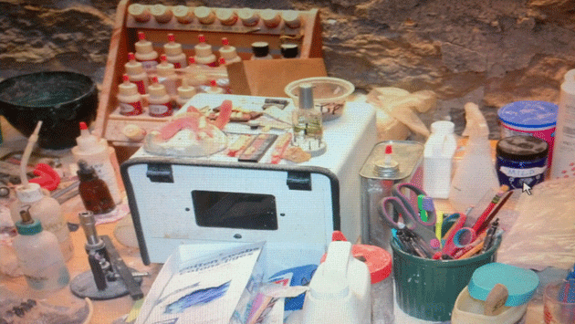

Slide 5
Dental gray market
Gray market
The term “gray market” Is a generic term that primarily refers to products that are traded or sold outside of the manufactures authorized distribution channels.
Also know as parallel market , is an unauthorized and non-secure distribution channel through which products and materials are sold.
Unlike black markets , which are used to distribute stolen, defective or counterfeit products and are by definition illegal, gray markets exist under a much less – defined jurisdiction .

Slide 6
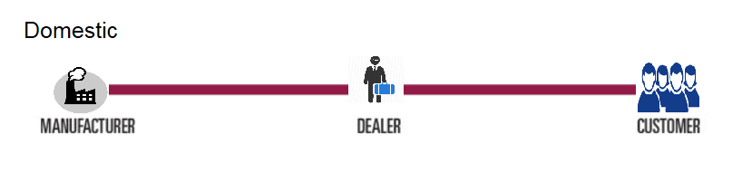
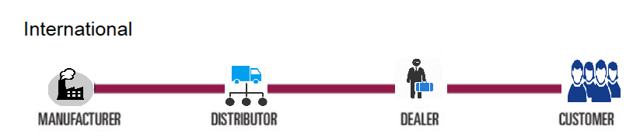
Shades of gray
OFF-WHITE

Slide 7
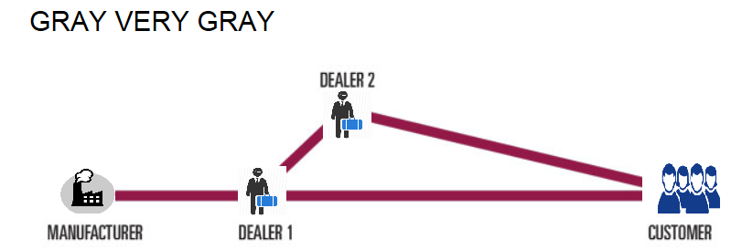
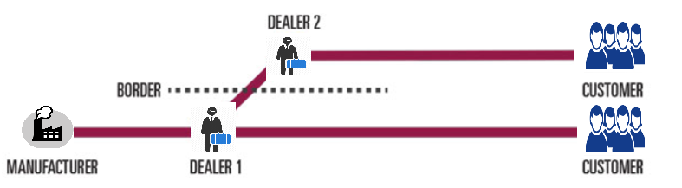

Slide 8
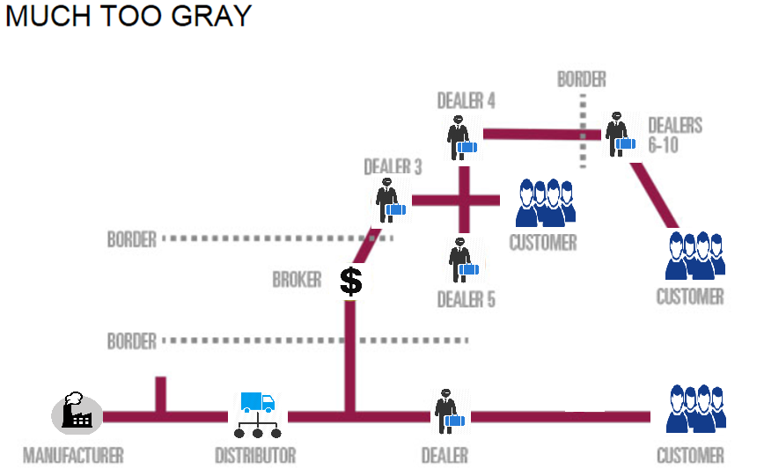

Slide 9
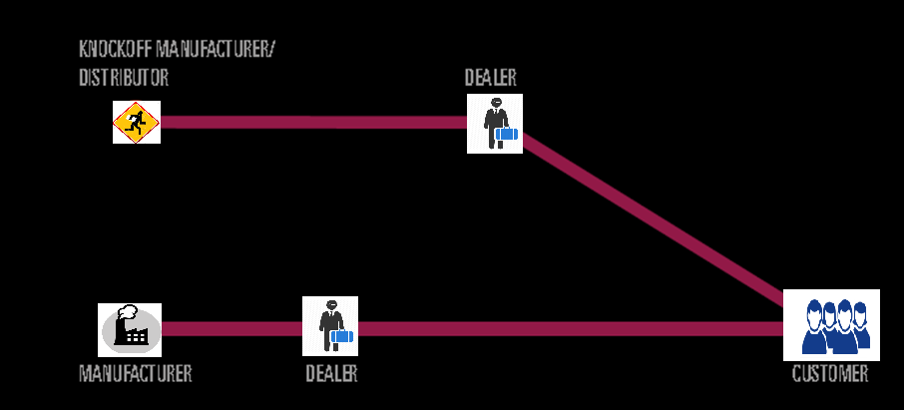
Black

Slide 10
the World Health Organization
the World Health Organization (WHO) estimate that approximately 6% to 8% of the total global medical devices market comprises counterfeit goods.
This percentage does not consider unaudited and unaccounted markets where the problem might be more serious.

Slide 11
“Dentist have a responsibility to inquire about the truth , accuracy and performance of products to help ensure they are providing safe and effective care for their patient .’’
-The American Dental Association

Slide 12
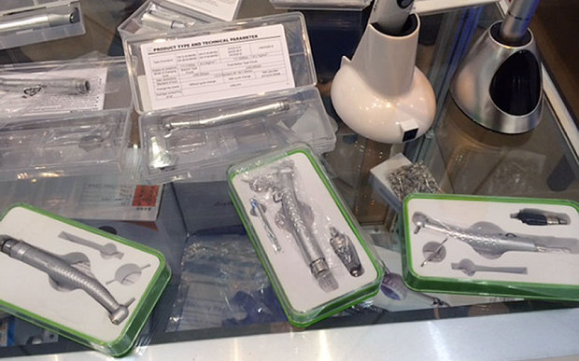
MHRA investigate
The Medicines and Healthcare products Regulatory Agency (MHRA) - the UK's regulator for medical devices and medicines –
has six ongoing investigations involving the purchase of counterfeit and unapproved dental equipment such as high-speed hand-pieces drills from auction websites by UK dentists.
The seized items include 24 dental X-ray machines that emit high levels of radiation, 384 hand-piece drills that could malfunction and disintegrate inside patients' mouths and 3,242 poor quality root canal files that could break.
poor quality dental equipment imported into the UK from China and Pakistan and sold on auction.

Slide 13
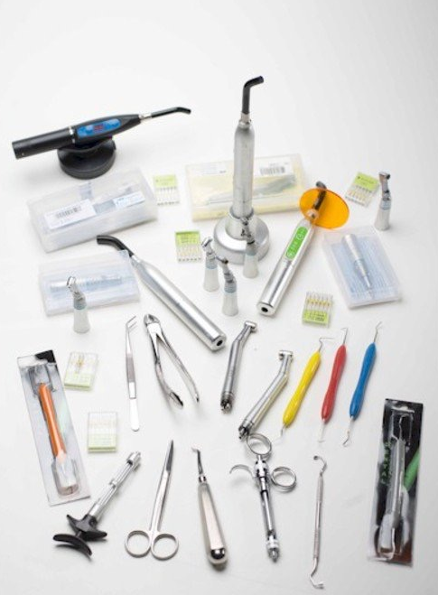

Slide 14
One high profile case in 2012 was that of Barrington Armstrong-Thorpe, an Essex-based man who sold ‘dangerous’ home teeth whitening kits over the internet. He sold kits online using the name Smile Brighter Marketing, claiming they were FDA/EU approved. When sent to the lab, the gel in its Smile Bright kits was found to contain 10.3 percent hydrogen peroxide. Only 0.1 per cent is allowed in DIY kits and dentists use a maximum of six per cent. This level is deemed dangerous as it can strip enamel from teeth, cause receding gums, make teeth darker, and make teeth very sensitive.
DIY: Do It Yourself

Slide 15
My job as clinician is to ensure that patient are treated with safe effective devices and materials that meet the standard .
Dr.yazeed Alshowaier

Slide 16
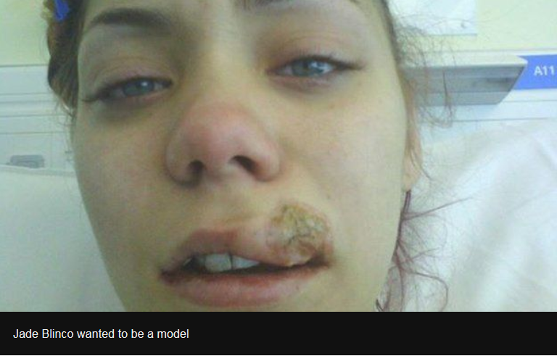
This case was reported in UK
The patient was injured by poorly maintained dental equipment, not imported tools, but it is a reminder of the importance of safety standards
The 24-year-old, who wanted to be a model, was left with a scar after a drill broke in her mouth.
She said: "My face feels funny in winter and summer, hot and cold food, it tingles.
"I constantly worry about it - I feel it pulling and tugging even when I'm talking."

Slide 17
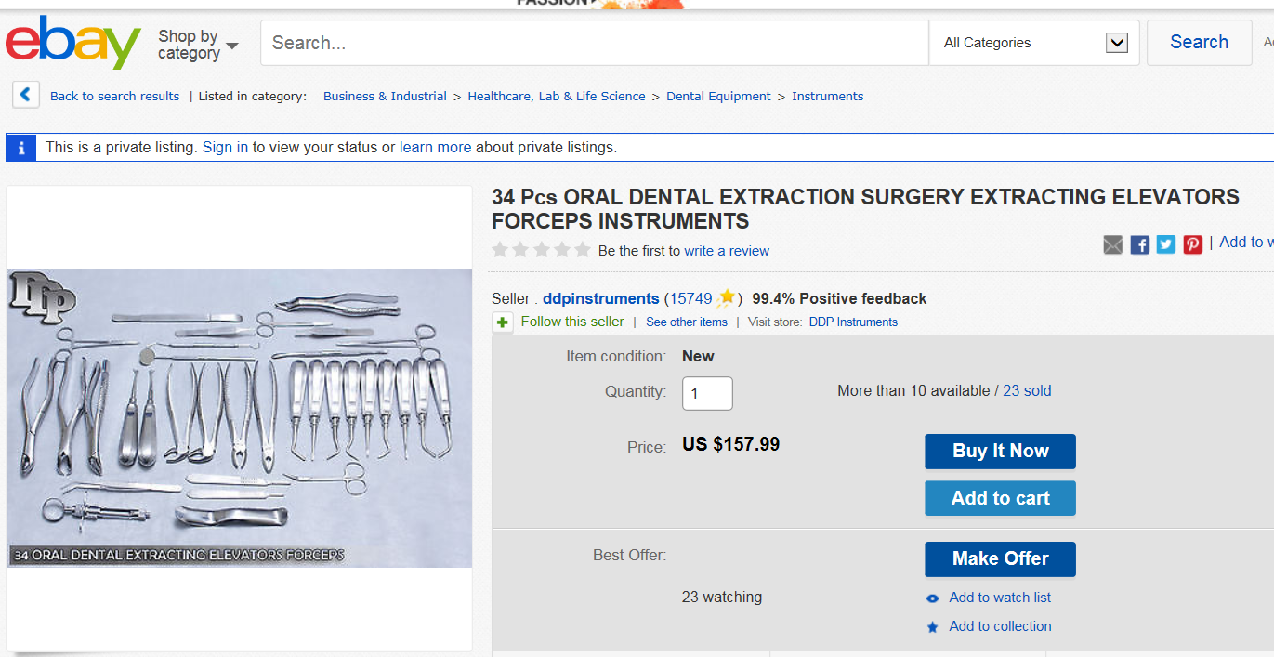
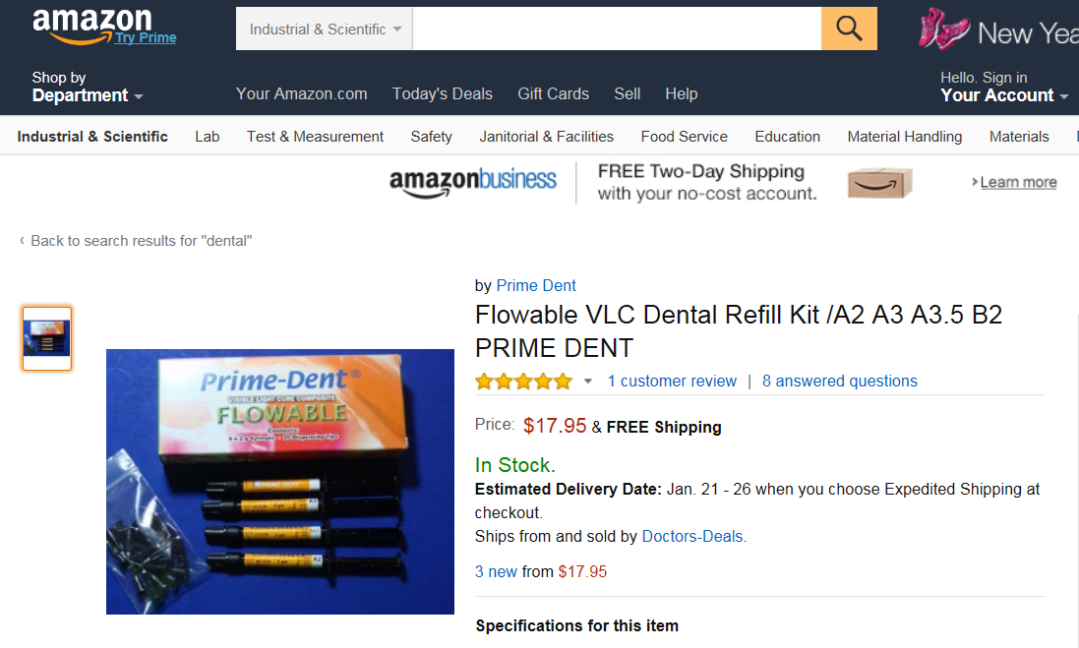
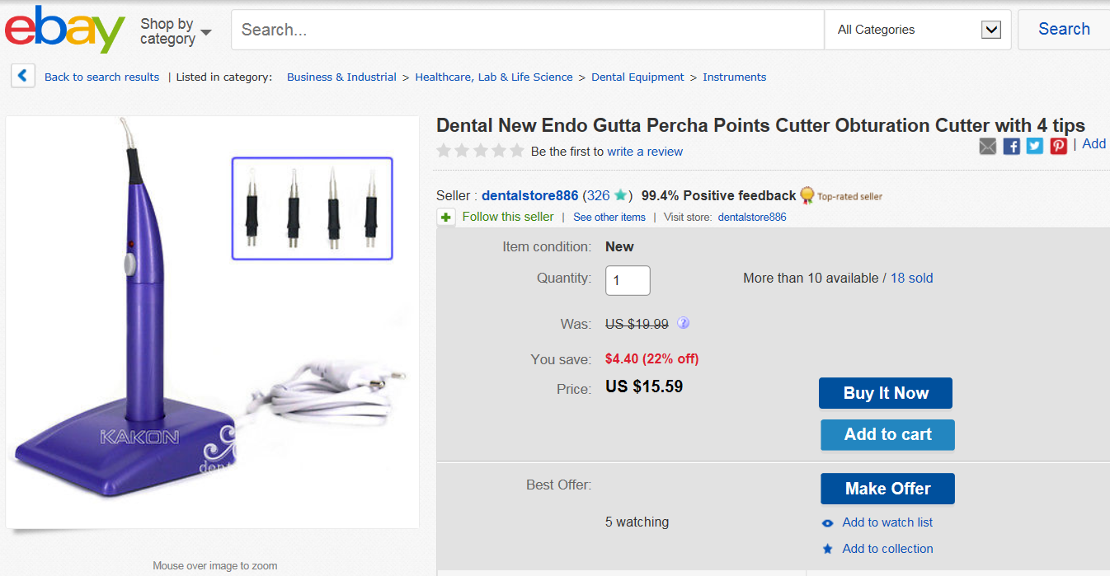
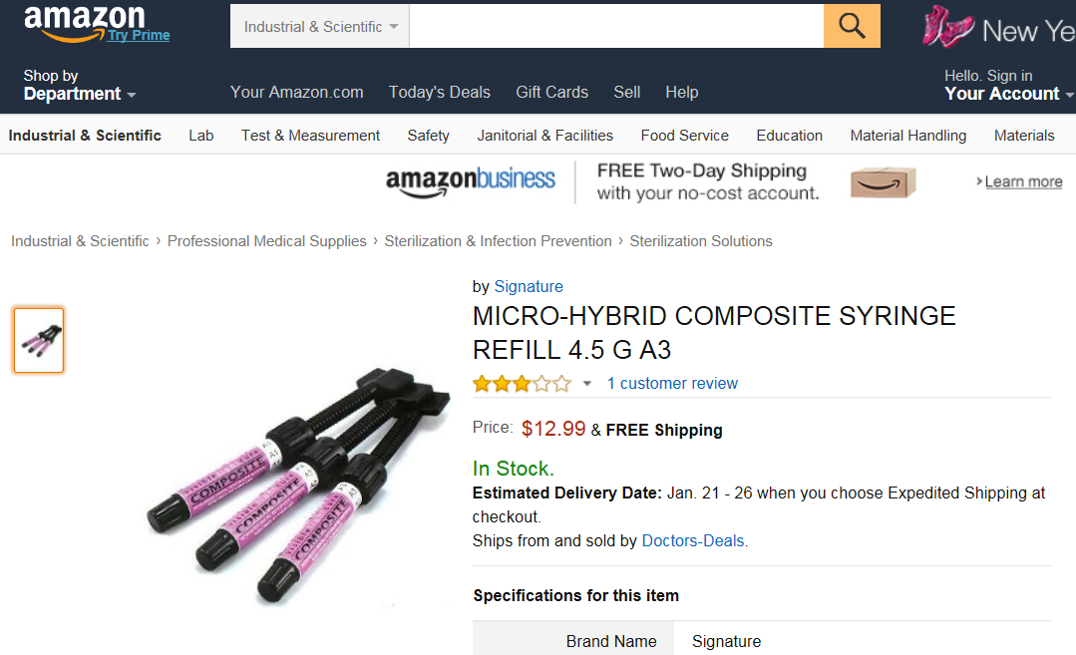

Slide 18
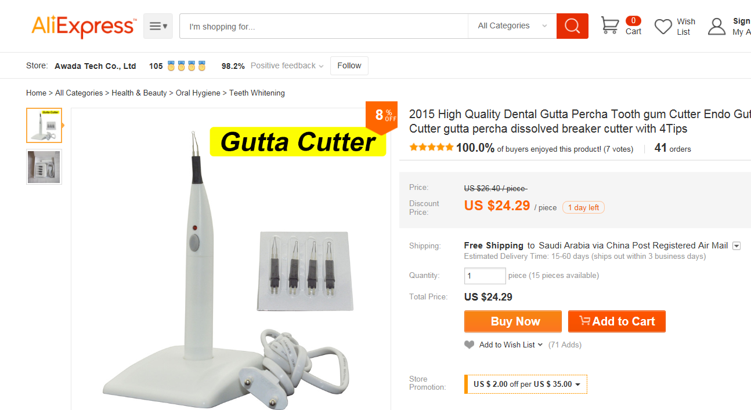
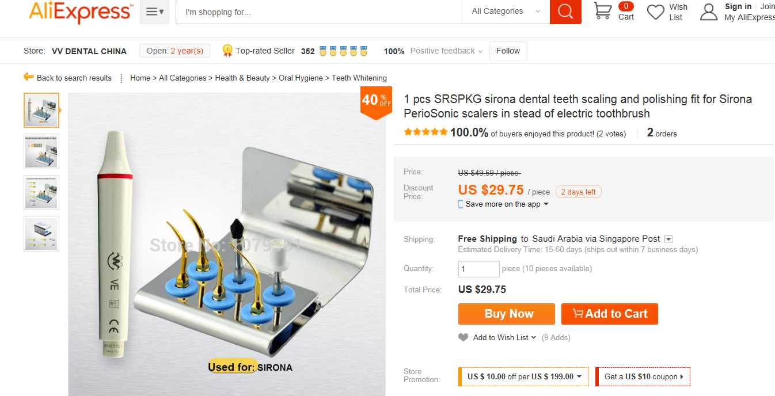

Slide 19
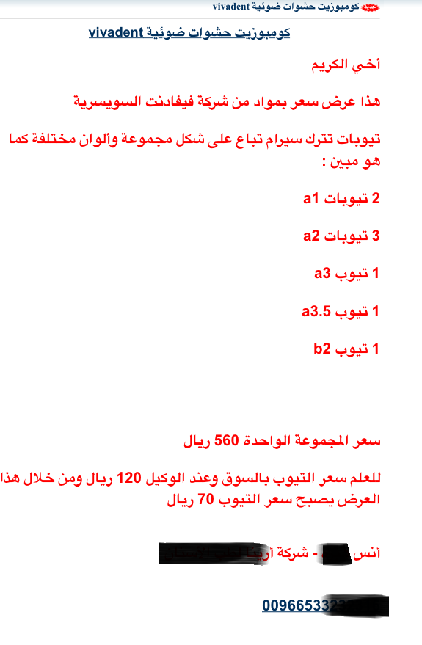
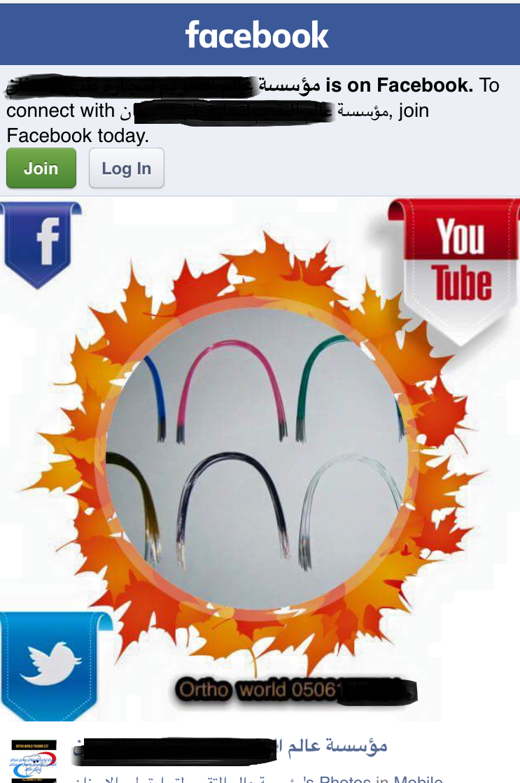
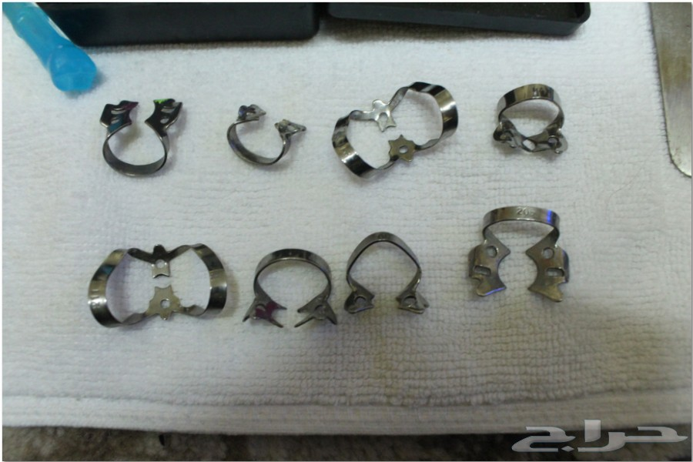
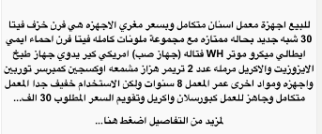
Cases in Saudi market

Slide 20
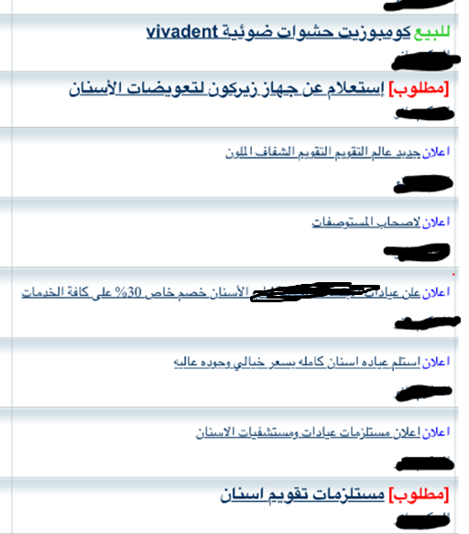
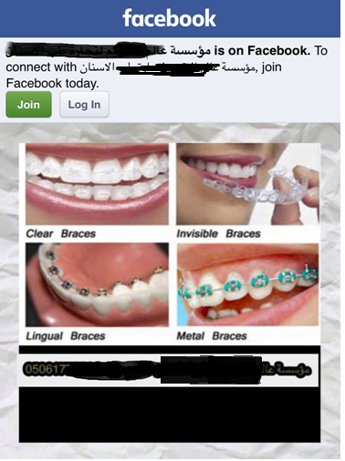

Slide 21
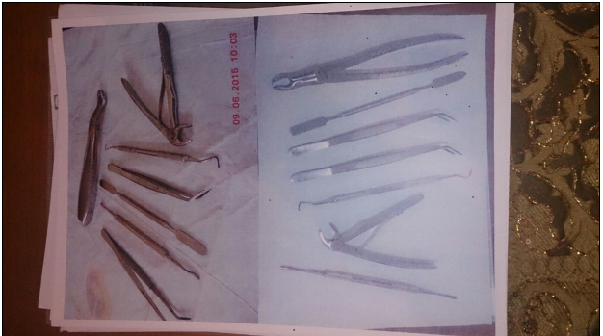

استخدام سفرة بيت الشواية لعرض المنتجات

Slide 22
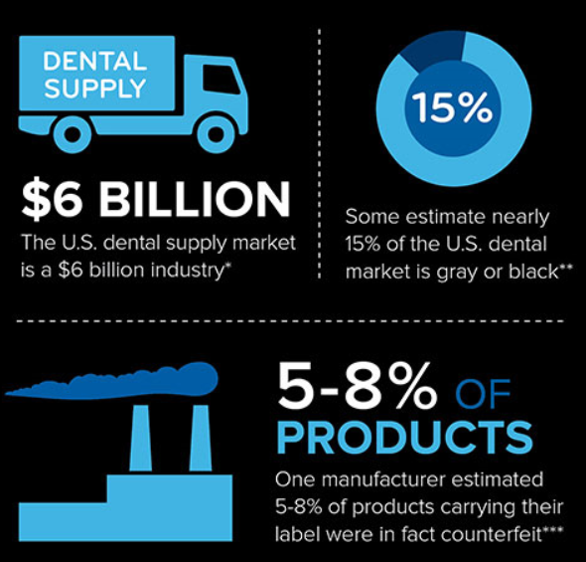
Patient safety is at risk

Slide 23
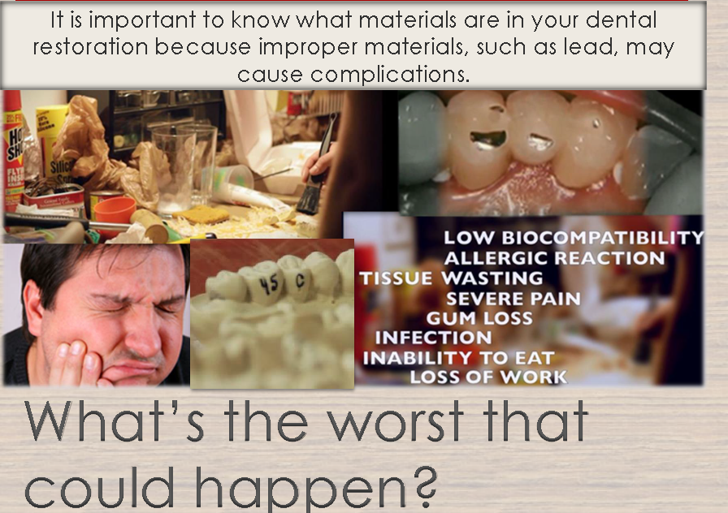

Slide 24
Low biocompatibility
Allergic reaction
Tissue wasting
Severe pain
Gum loss
Infection
Inability to eat
Loss of work
Waste of time and money

Slide 25
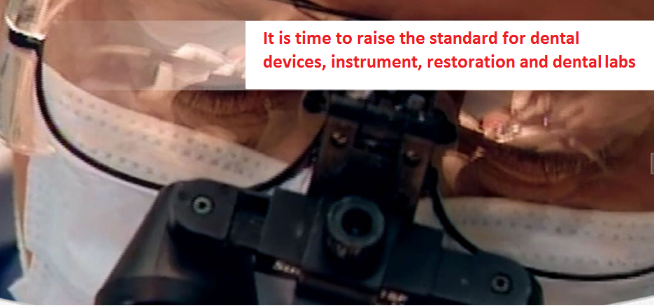
The Bottom Line

Slide 26
In August 2013, manufacturer W&H reported that fake Alegra TE-95 RM turbines were being sold in their name in some countries, particularly in the Middle East and North Africa. The fake hand pieces looked similar to the original ones from W&H and had similar packaging and instructions for use, showing just how sophisticated these products can be. However one thing caught them out; they all had the same serial number: 101483.

Slide 27
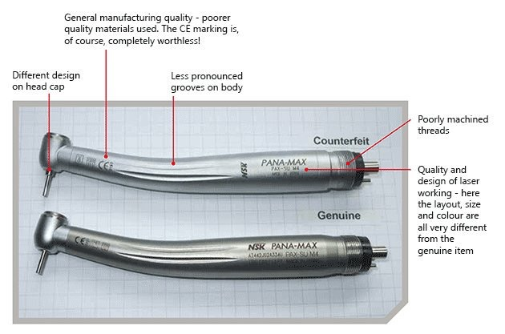

Slide 28
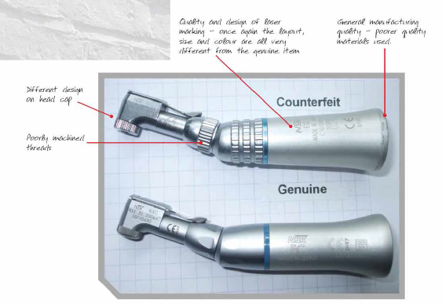

Slide 29

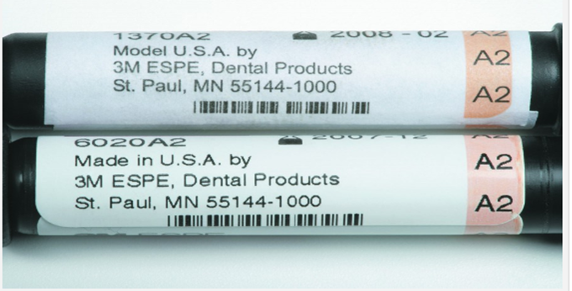
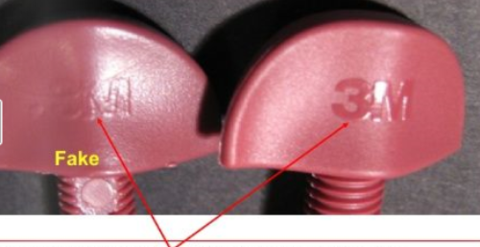
Counterfeit composite restoration

Slide 30
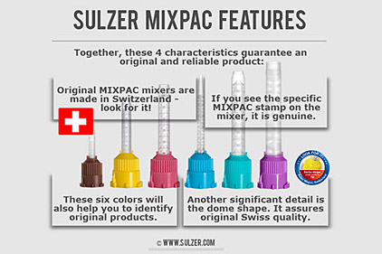
If a dental materials counterfeiter could fool experts who run dental supply companies, they can certainly fool dental practitioners.”

Slide 31
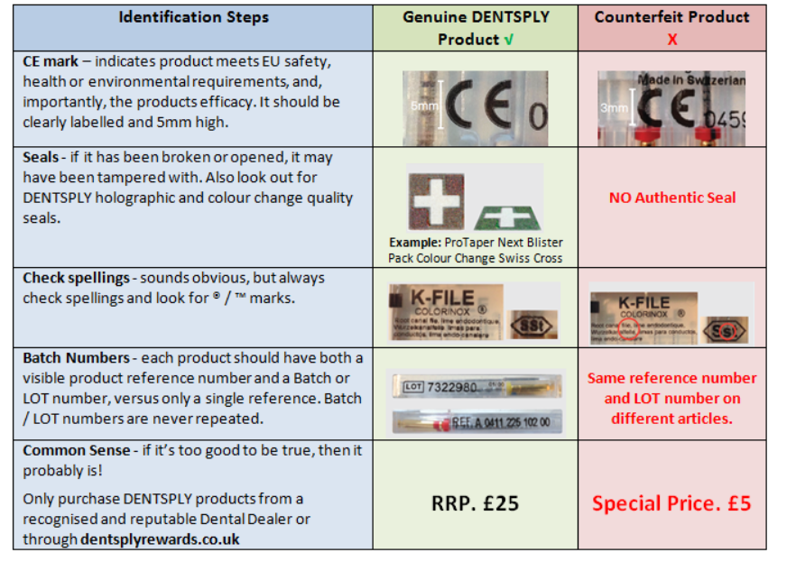
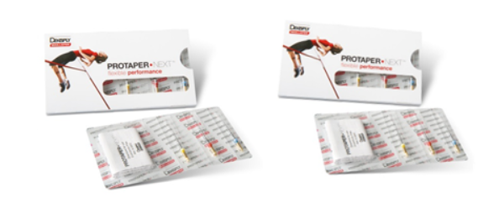

Slide 32
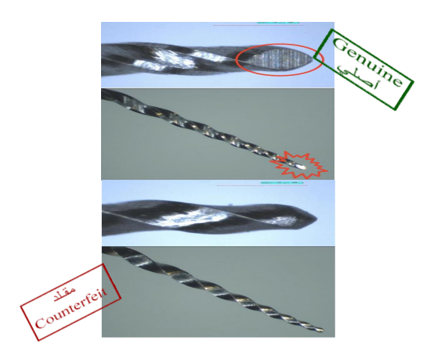
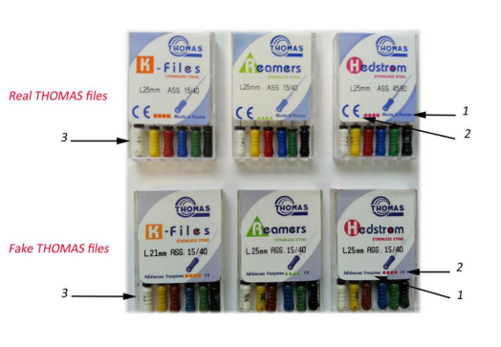
Dental file marketed in KSA at NewmatFrench company, reported by a patient because it broke. Investigation lead to discovering that it is a counterfeit product

Slide 33
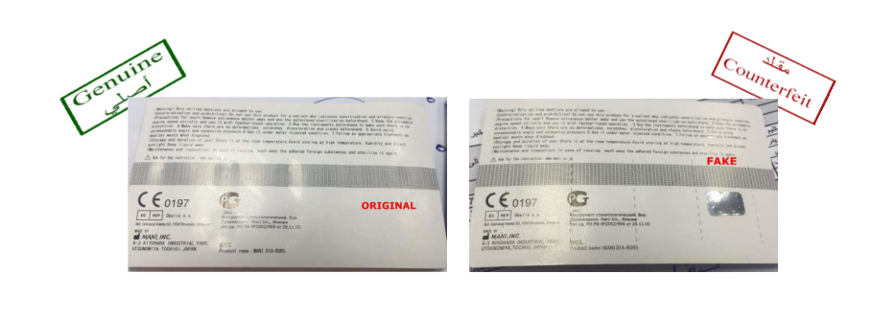
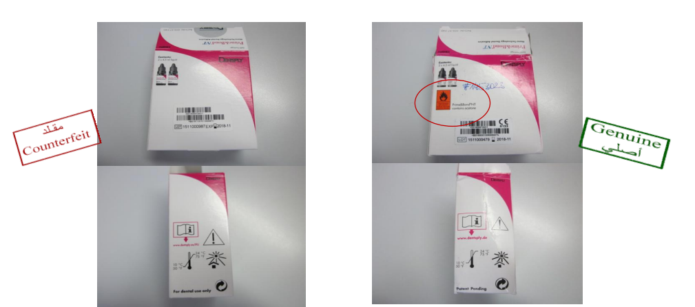
Root canal files Counterfeited
Dental Glue by PRIME & BOND NT An Alert was sent by the manufacturer to warn against counterfeited product being marketed globally

Slide 34
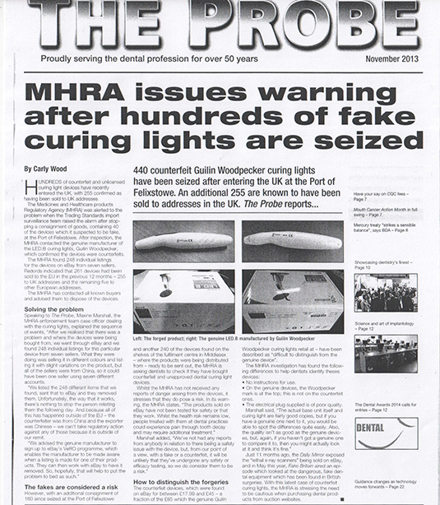
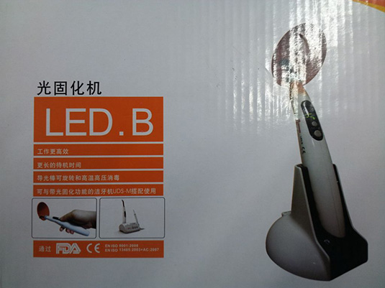
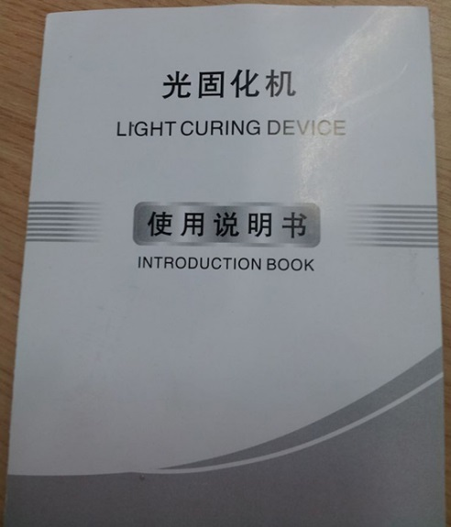
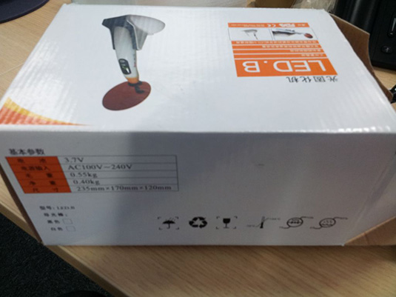
can lead to problems such as lower bond strengths and increased potential for micro leakage, color changes within the composite resin, surface staining, wear, and recurrent caries.

Slide 35
In November 2013, the Medicines and Healthcare Regulatory Agency (MHRA) reported that fake dental curing lights were being sold on eBay and that they had not been tested for safety or that they work. The MHRA said people treated with them at dental practices could experience pain through tooth decay and may require additional treatment.

Slide 36
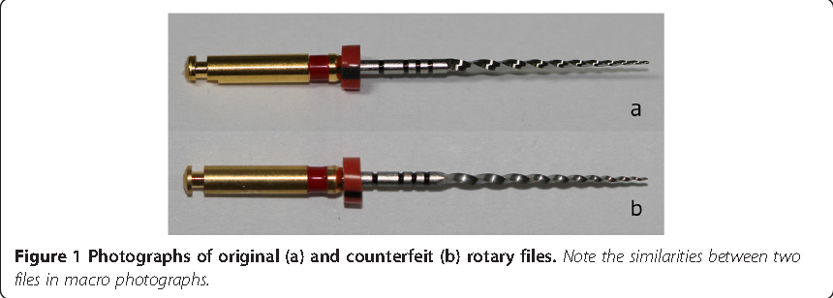
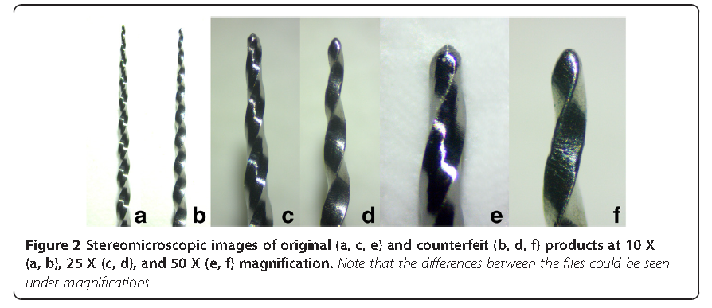
Comparison of cyclic fatigue resistance of original and counterfeit rotary instruments by Huseyin Ertas1*, Ismail Davut Capar1, Hakan Arslan2 and Ender Akan3
Conclusions: The cyclic fatigue resistance of the counterfeit instruments was very low. As a result, clinicians should be careful not to purchase counterfeit products.

Slide 37
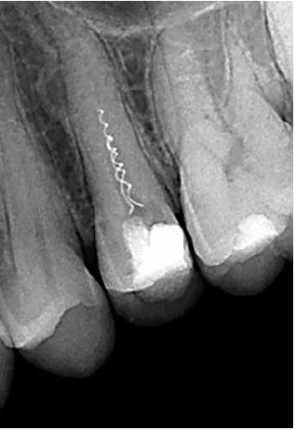
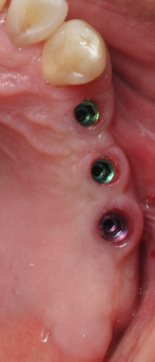

This is a case for Dr. Stephane Simon patient with fractured instrument.
The average treatment price for fracture instrument removal
1700-2000 and should be done by endodontic consultant .
The average treatment price for apicoectomy is 1800-2000
The average treatment price for dental implant is 6000-12000

Slide 38
Fighting back
The dental industry is regulated by the SFDA to ensure that the dental products used and placed in patients' mouths meet the standards and safety .
"Medical Devices Law" issued by the Royal Decree No. (M/54) dated 6/7/1442 H
"Implementing Regulation of Medical Devices Law" issued by Saudi Food and Drug Authority Board of Directors decree No. (3-29-1443) dated 19/2/1443H

Slide 39
Fighting back internationally
Cooperation with MOH and the GCC countries for the recognition of Companies Where they found some phantom companies that do not exist.
Cooperation with regulators (WHO,MHRA,FDA, Health Canada, PMDA,…..)

Slide 40
Fighting back nationally
Cooperation with Saudi custom to control the border .
Cooperation with Saudi dental society's
cooperation with ministry of health and government and privet health providers
cooperation with importers and distributors
Rising the issue throw conference's ,lecture's for all health providers

Slide 41
Reminder for regulators and dentist
you are not buying an electronic gadget for your own use on the grey market and taking your chances, You are releasing or using a product that is going inside a patient’s mouth and you only have to be wrong once for this to have serious consequences.

Slide 42
Thank You

